Slide 1

Software Design and Arcitecture(SDA) Lecture 11
Engr.Ramsha Mashood
Senior Lecturer
Department of Software Engineering
Bahria University Karachi Campus

Slide 2




architectural design PATTERNS

Slide 3
Software architecture Definition
The design process for identifying the sub-systems making up a system and the framework for sub-system control and communication is architectural design.
The output of this design process is a description of the software architecture.

Slide 4
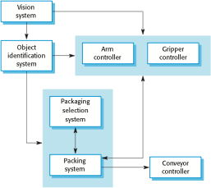
The architecture of a packing robot control system – Box and Line Diagram

Slide 5
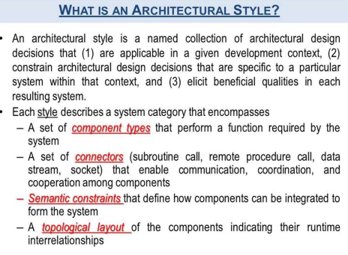

Slide 6
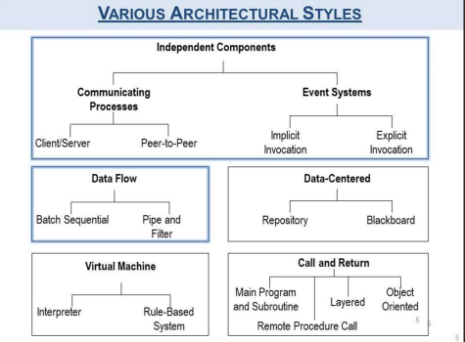

Slide 7
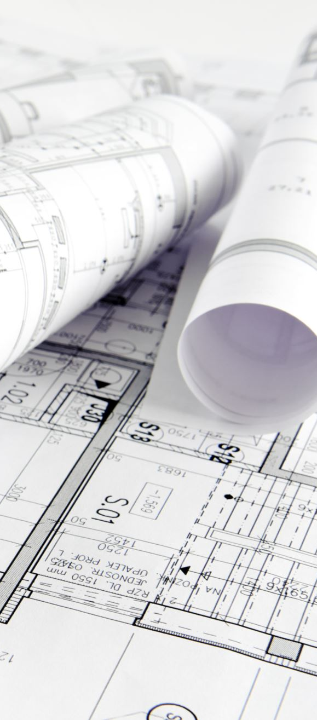
Architectural design decisions – common questions (though a creative process)
Is there a generic application architecture that can be used?
How will the system be distributed?
What architectural styles are appropriate?
What approach will be used to structure the system?
How will the system be decomposed into modules?
What control strategy should be used?
How will the architectural design be evaluated?
How should the architecture be documented?

Slide 8

Architecture and system characteristics
Performance
Localise critical operations and minimise communications. Use large rather than fine-grain components or replicate.
Security
Use a layered architecture with critical assets in the inner layers.
Safety
Localise safety-critical features in a small number of sub-systems.
Availability
Include redundant components and mechanisms for fault tolerance.
Maintainability
Use fine-grain, replaceable components.

Slide 9
4 + 1 view model of software architecture
A logical view, which shows the key abstractions in the system as objects or object classes.
A process view, which shows how, at run-time, the system is composed of interacting processes.
A development view, which shows how the software is decomposed for development.
A physical view, which shows the system hardware and how software components are distributed across the processors in the system.
Related using use cases or scenarios (+1)

Slide 10
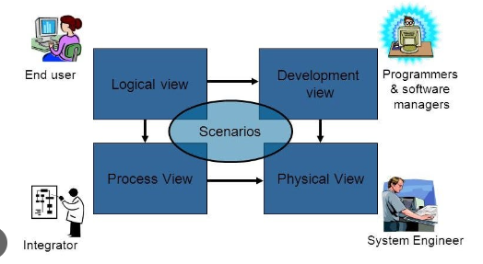

Slide 11
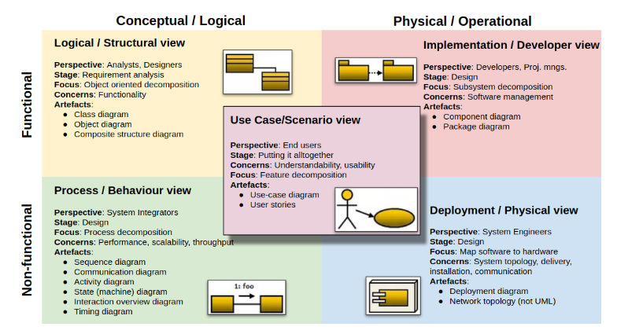

Slide 12

Architectural patterns
Patterns are a means of representing, sharing and reusing knowledge.
An architectural pattern is a stylized description of good design practice, which has been tried and tested in different environments.
Patterns should include information about when they are and when the are not useful.
Patterns may be represented using tabular and graphical descriptions.

Slide 13
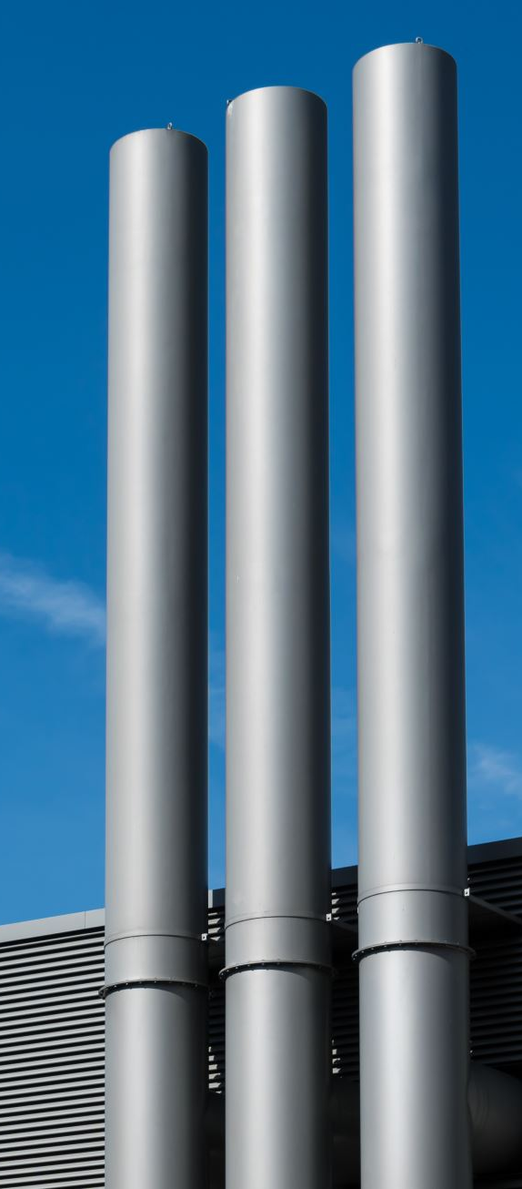
Generic Architecture Models
Repository
Client Server
Pipe and Filter

Slide 14
Repository architecture
Sub-systems must exchange data. This may be done in two ways:
Shared data is held in a central database or repository and may be accessed by all sub-systems;
Each sub-system maintains its own database and passes data explicitly to other sub-systems.
When large amounts of data are to be shared, the repository model of sharing is most commonly used a this is an efficient data sharing mechanism.

Slide 15
The Repository Architecture pattern
Name | Repository
Description | All data in a system is managed in a central repository that is accessible to all system components. Components do not interact directly, only through the repository.
Example | Figure 6.9 is an example of an IDE where the components use a repository of system design information. Each software tool generates information which is then available for use by other tools.
When used | You should use this pattern when you have a system in which large volumes of information are generated that has to be stored for a long time. You may also use it in data-driven systems where the inclusion of data in the repository triggers an action or tool.
Advantages | Components can be independent—they do not need to know of the existence of other components. Changes made by one component can be propagated to all components. All data can be managed consistently (e.g., backups done at the same time) as it is all in one place.
Disadvantages | The repository is a single point of failure so problems in the repository affect the whole system. May be inefficiencies in organizing all communication through the repository. Distributing the repository across several computers may be difficult.

Slide 16
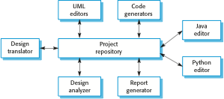
A repository architecture for an IDE

Slide 17
Client-server architecture
Distributed system model which shows how data and processing is distributed across a range of components.
Can be implemented on a single computer.
Set of stand-alone servers which provide specific services such as printing, data management, etc.
Set of clients which call on these services.
Network which allows clients to access servers.

Slide 18
The Client–server pattern
Name | Client-server
Description | In a client–server architecture, the functionality of the system is organized into services, with each service delivered from a separate server. Clients are users of these services and access servers to make use of them.
Example | Figure 6.11 is an example of a film and video/DVD library organized as a client–server system.
When used | Used when data in a shared database has to be accessed from a range of locations. Because servers can be replicated, may also be used when the load on a system is variable.
Advantages | The principal advantage of this model is that servers can be distributed across a network. General functionality (e.g., a printing service) can be available to all clients and does not need to be implemented by all services.
Disadvantages | Each service is a single point of failure so susceptible to denial of service attacks or server failure. Performance may be unpredictable because it depends on the network as well as the system. May be management problems if servers are owned by different organizations.

Slide 19
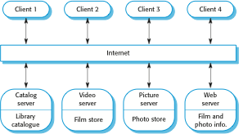
A client–server architecture for a film library

Slide 20
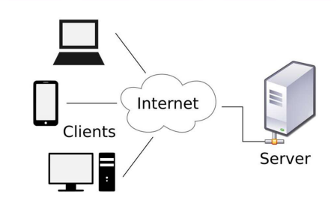

Slide 21
Peer-to-peer pattern
In this pattern, individual components are known as peers.
Peers may function both as a client, requesting services from other peers, and as a server, providing services to other peers.
A peer may act as a client or as a server or as both, and it can change its role dynamically with time.
Usage
File-sharing networks such as Gnutella and G2)
Multimedia protocols such as P2PTV and PDTP.
Proprietary multimedia applications such as Spotify.

Slide 22
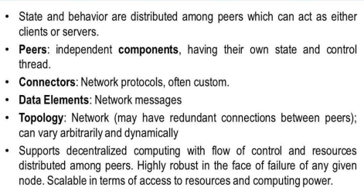

Slide 23
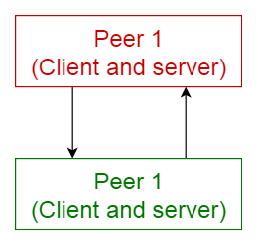

Slide 24
Continue….
Any thing to ask ??

